Slide 1
Some OOP Concepts in Java
Prepared by
Bal Krishna Subedi
St. Xavier’s College
Prepared by Bal Krishna Subedi

Slide 2
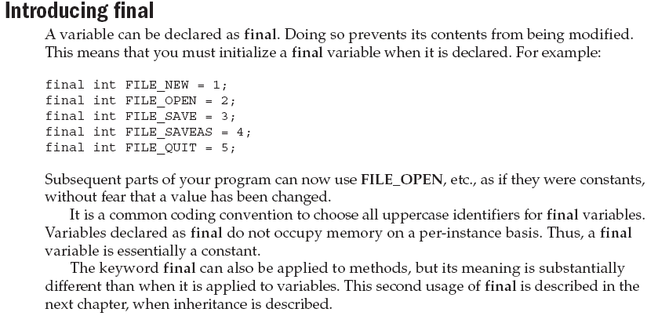
Prepared by Bal Krishna Subedi

Slide 3
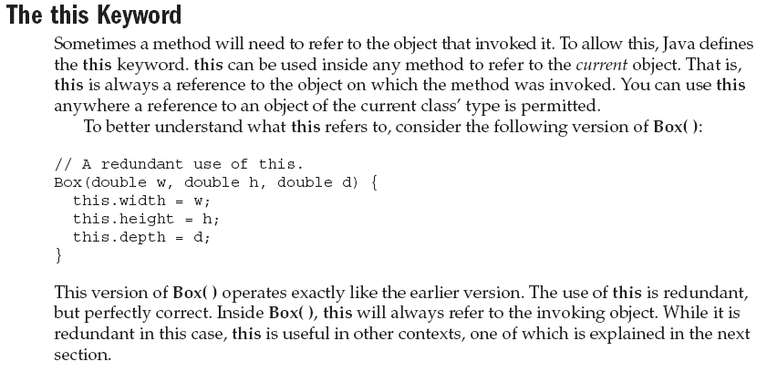
Prepared by Bal Krishna Subedi

Slide 4
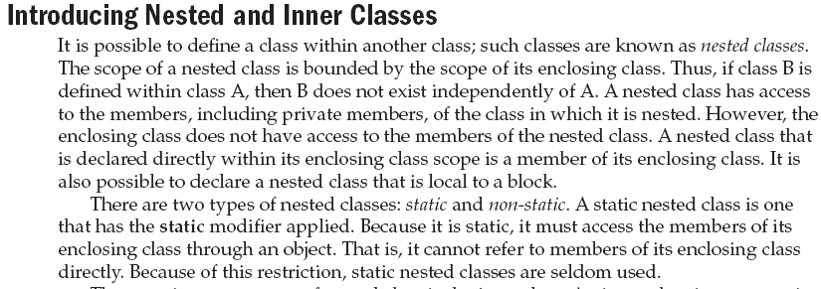
Prepared by Bal Krishna Subedi

Slide 5
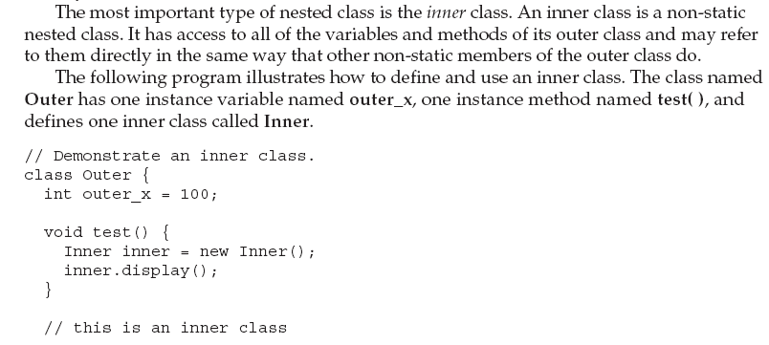
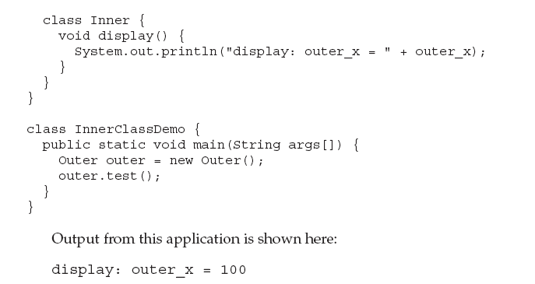
Prepared by Bal Krishna Subedi

Slide 6
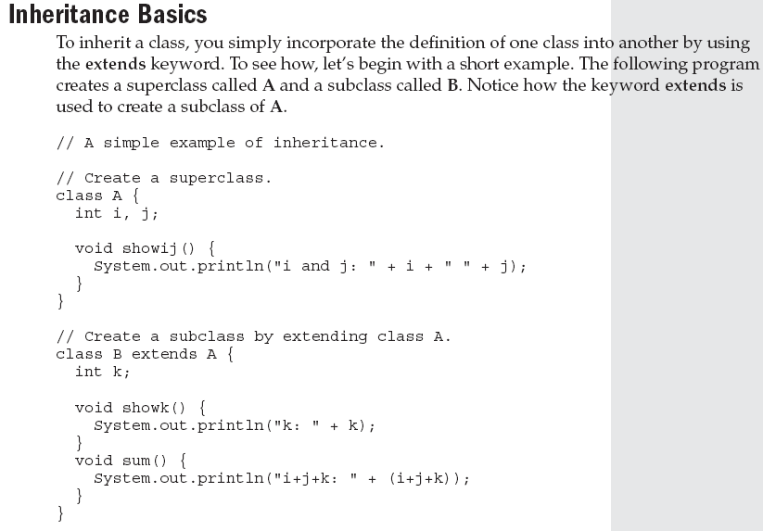
Inheritance
Prepared by Bal Krishna Subedi

Slide 7
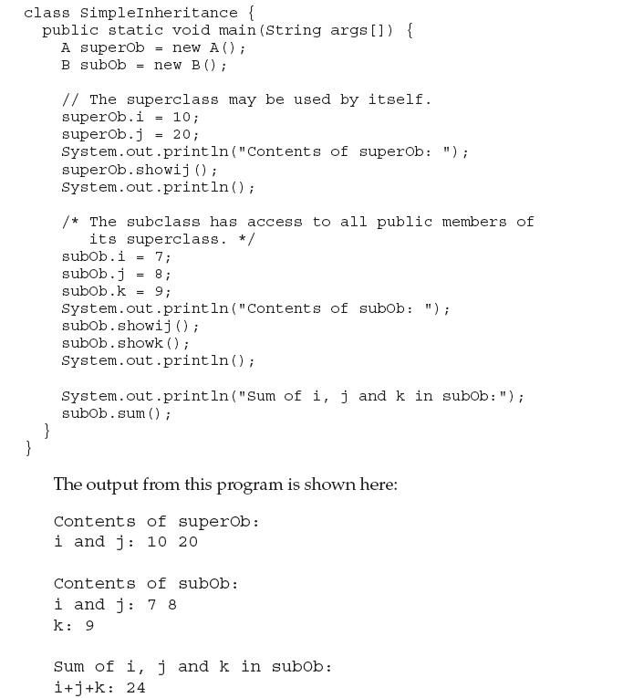
Prepared by Bal Krishna Subedi

Slide 8
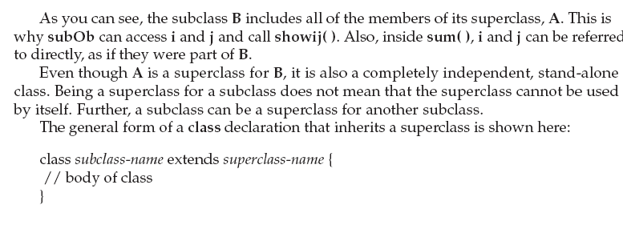
Prepared by Bal Krishna Subedi

Slide 9
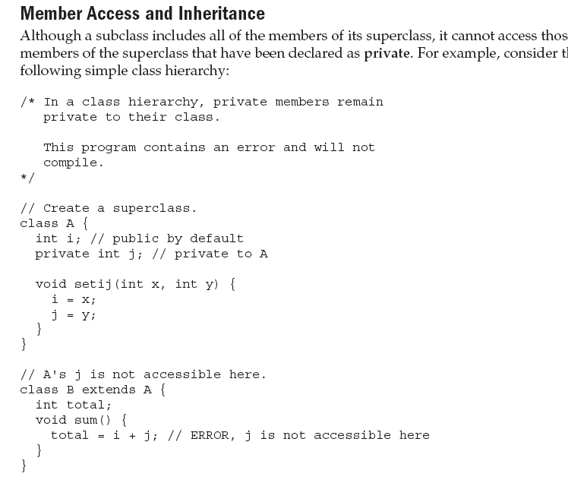
Prepared by Bal Krishna Subedi

Slide 10
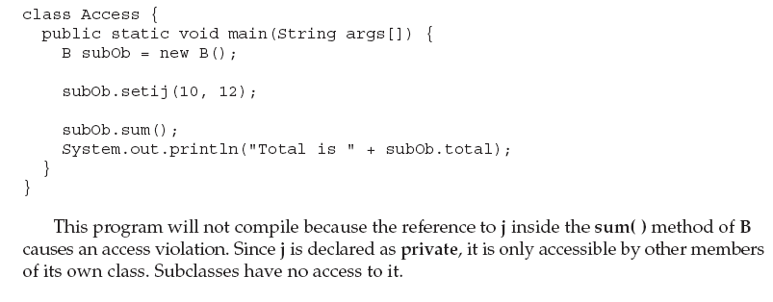
Prepared by Bal Krishna Subedi

Slide 11
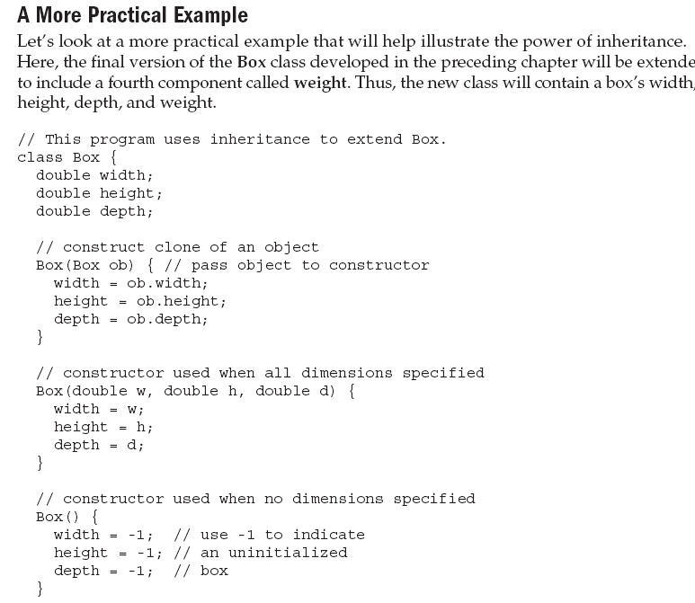
Prepared by Bal Krishna Subedi

Slide 12
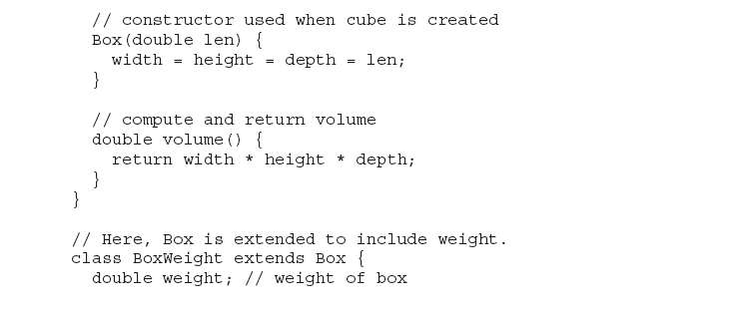
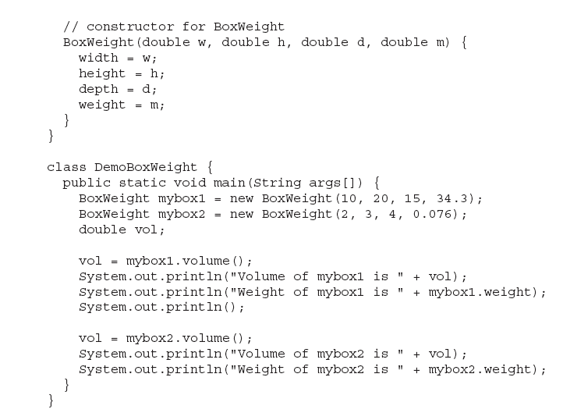
Prepared by Bal Krishna Subedi

Slide 13
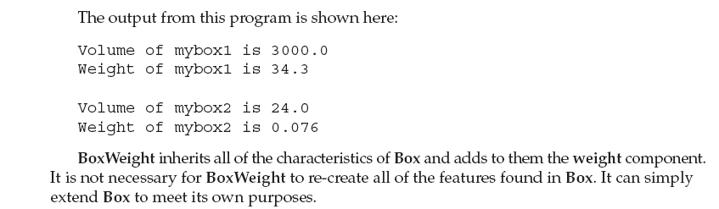
Prepared by Bal Krishna Subedi

Slide 14
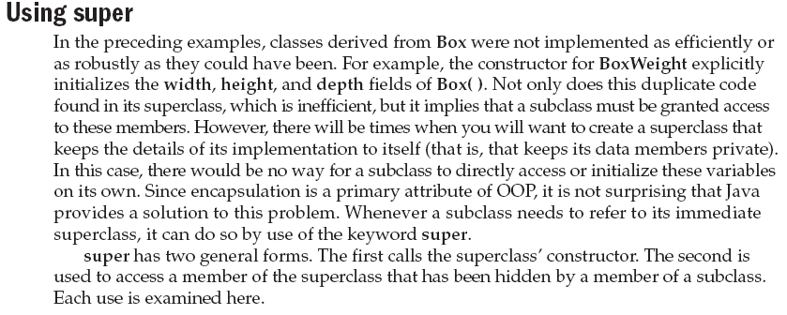
Prepared by Bal Krishna Subedi

Slide 15
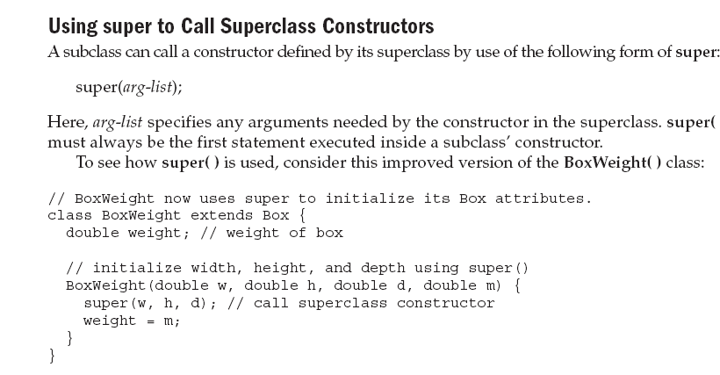
Prepared by Bal Krishna Subedi

Slide 16
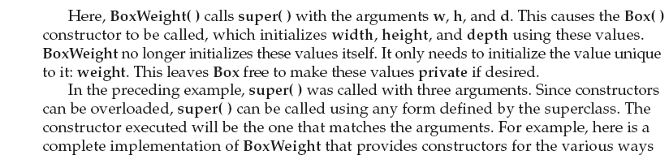
Prepared by Bal Krishna Subedi

Slide 17
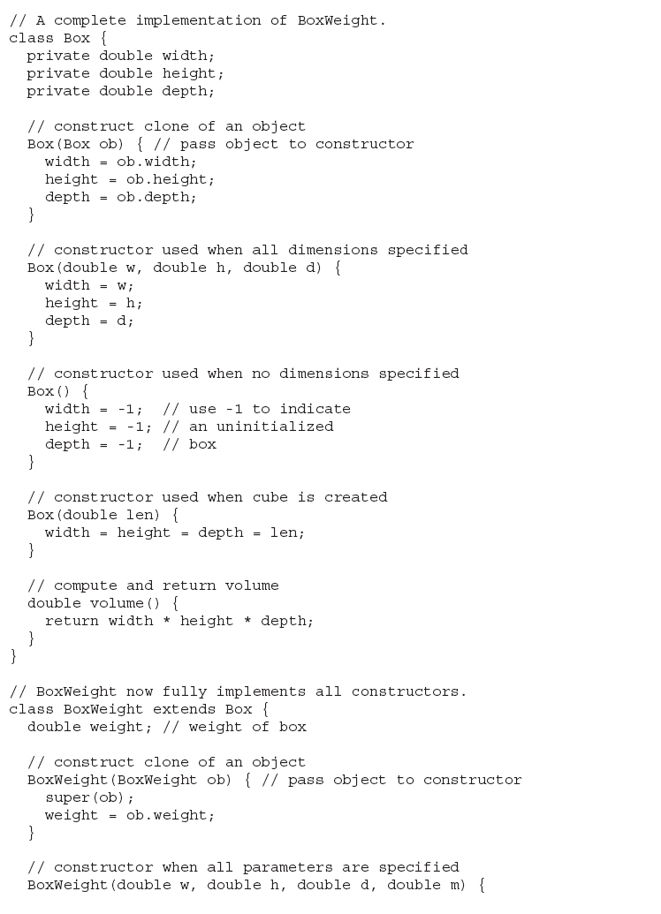
Prepared by Bal Krishna Subedi

Slide 18
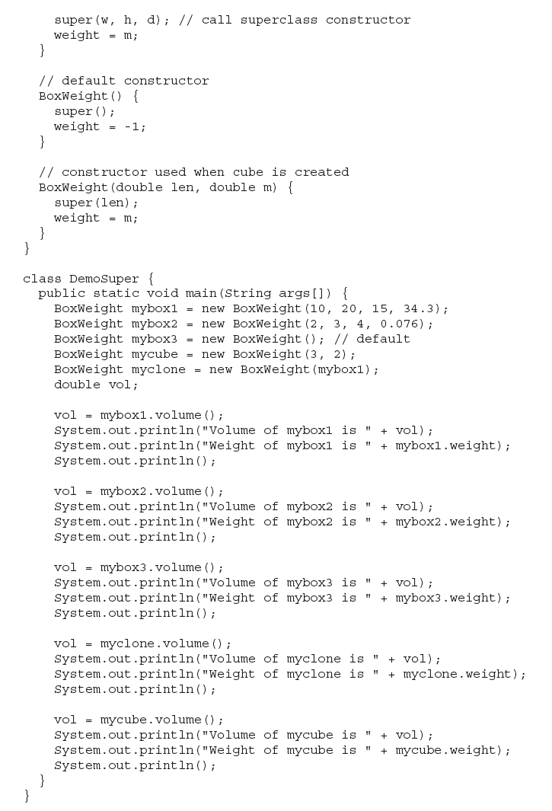
Prepared by Bal Krishna Subedi

Slide 19
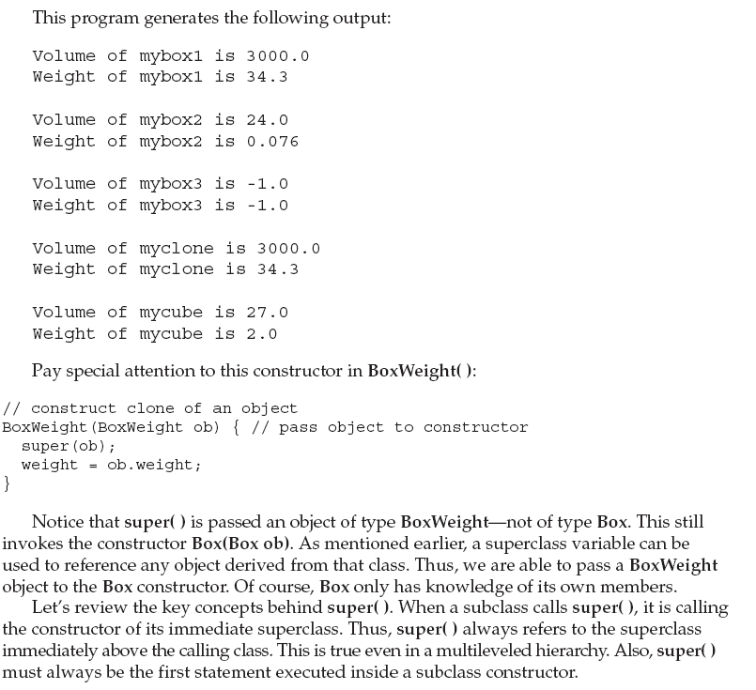
Prepared by Bal Krishna Subedi

Slide 20
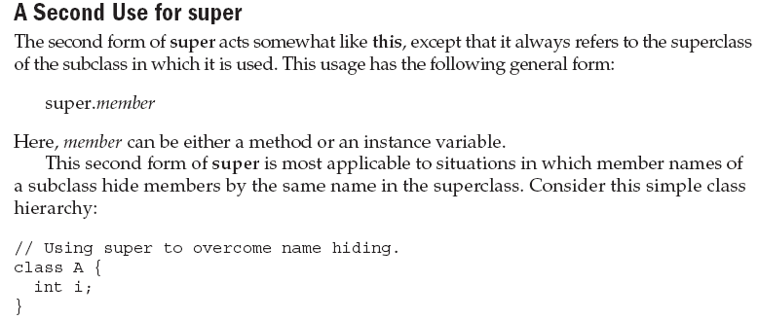
Prepared by Bal Krishna Subedi

Slide 21
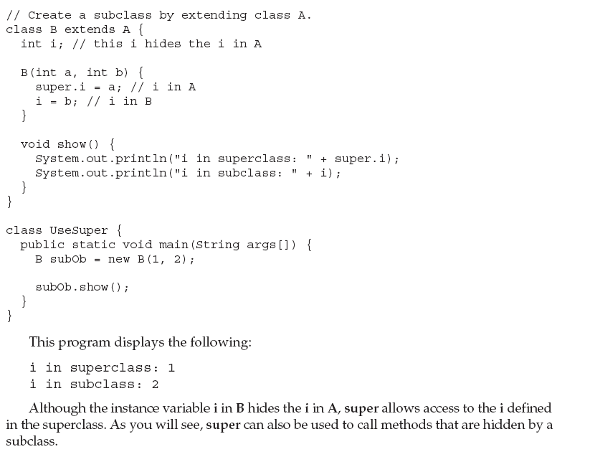
Prepared by Bal Krishna Subedi

Slide 22
Lab Assignment
Write a program to illustrate inheritance using super.
Write a program to calculate circumference of circle using final & this keyword.
Prepared by Bal Krishna Subedi

